Slide 1
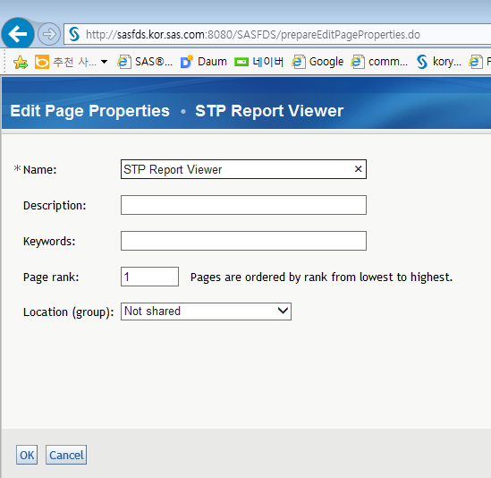
1. Portal Login as Portal Admin(sasadm@saspw)
2. Add Page ( [Customize] ➔ [Add Page]

Slide 2
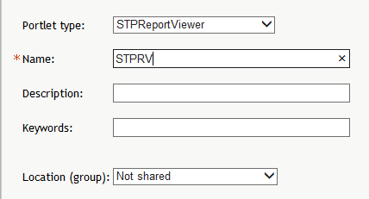
2. Add [STPWReportViwer] Portlet
[Customize] ➔ [Edit Page] ➔ [Edit Page Content]
Click [Add Portlets…] button.
Choose [STPReportViewer] in Portlet type

Slide 3
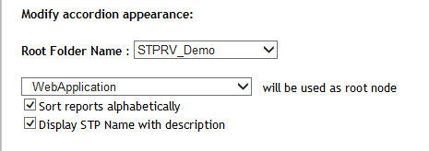
3. Click the [Edit Content] button in STPReportViewer Portlet
Change the following
Click the [SAVE] button.

